Slide 1
EE1002 / CG1108
PCB Options

Slide 2



Why use a PCB?
The LEDs and LDRs need to be mounted on the underside of the car, where there isn’t much space.
To do that, we can make use of small PCBs to ‘hold’ these components.
Logic
LDR
LED

Slide 3
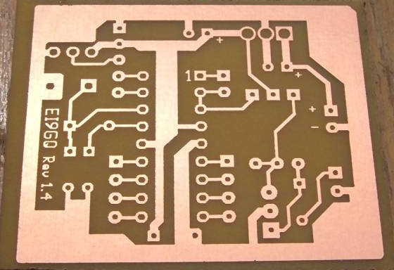
PCB?
PCB = Printed Circuit Board
Instead of wires, copper
tracks are ‘printed’ to
connect components
together
Substrate material = FR4
A type of glass-reinforced plastic.
To connect components to these copper tracks and secure them well, we use soldering.

Slide 4
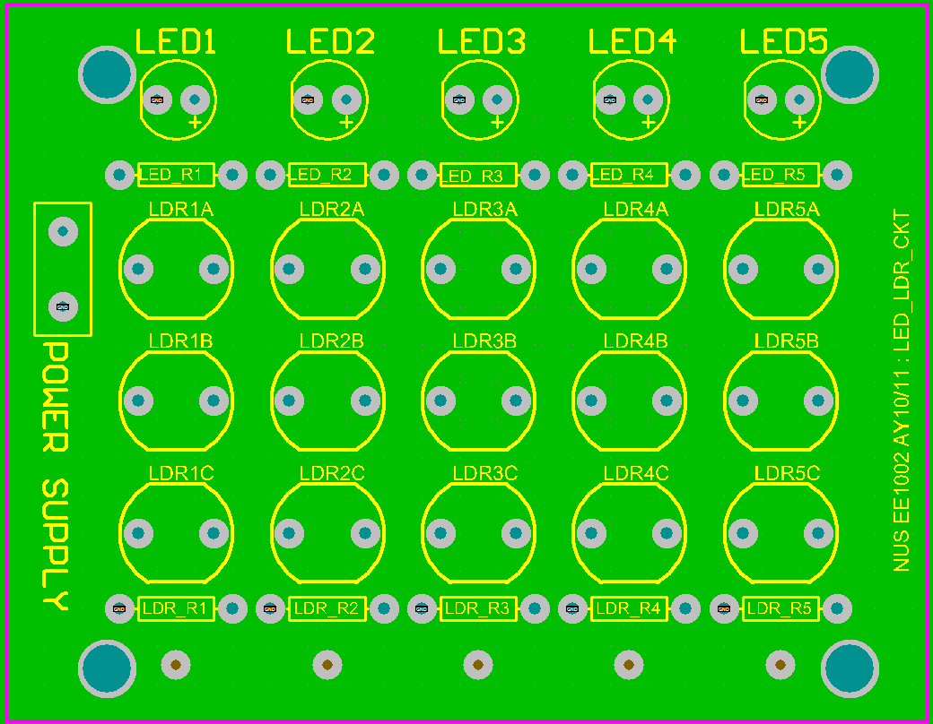
LED and LDR PCB
You can solder up to 5 LEDs here,
+ indicates anode of LED
5V Power Supply
Series resistor for LED to limit current flowing through LED
Ground (0V)

Slide 5
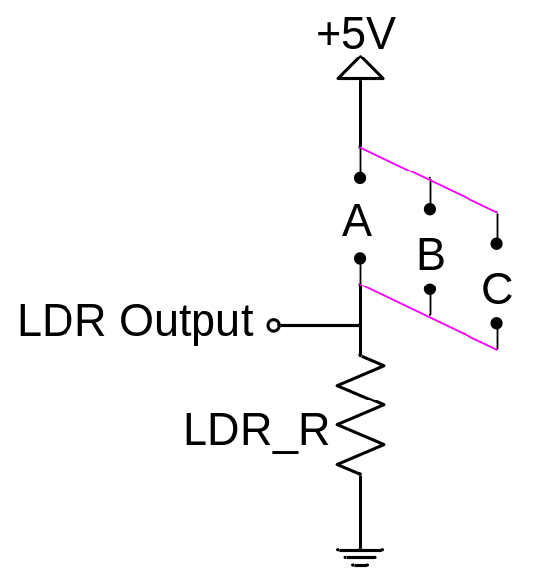
LED and LDR PCB
In each column, there are 3 possible locations for one LDR. You can solder the LDR into your preferred location.
A
B
C
Obtain the LDR output from here. Solder a wire to this point to connect to your breadboard.
Using this PCB, you can solder up to 5 LDRs.

Slide 6
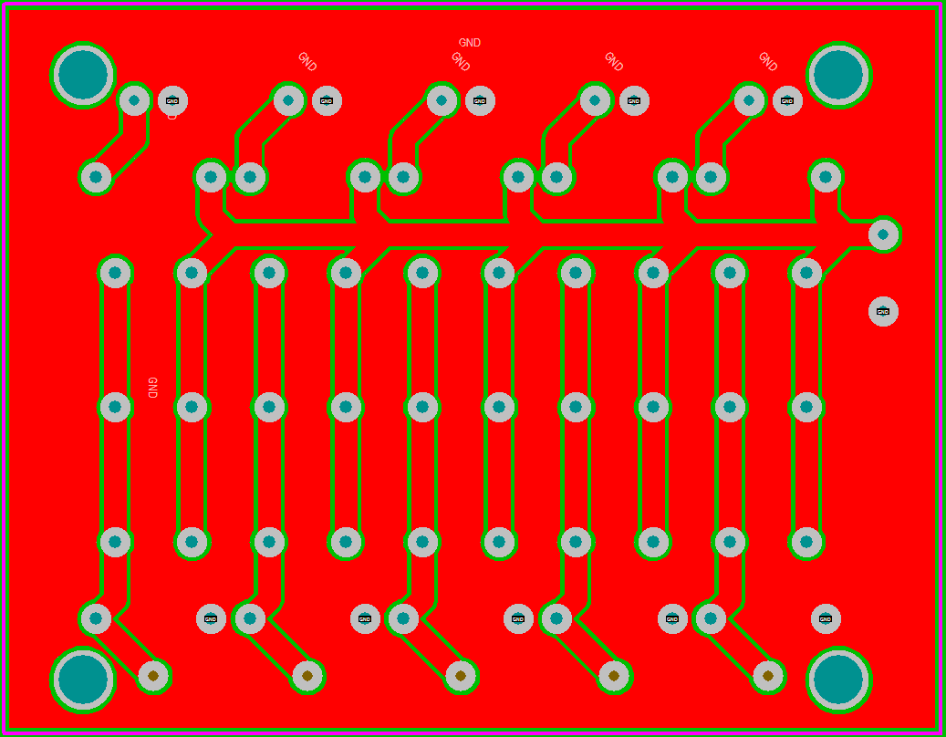
LED and LDR PCB
Back view of the PCB that shows how everything is connected. Points that are circled are connected to ground.

Slide 7
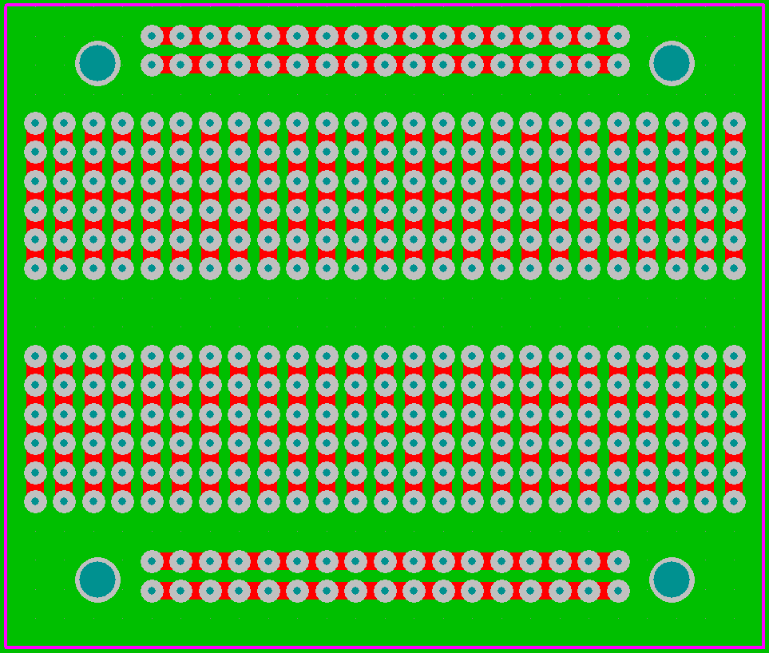
Small Breadboard PCB
If you prefer to use your own design instead of the LED LDR PCB, you can use this.
This PCB is designed to have connections exactly like a breadboard.
If you would like to implement any extra features, this PCB would be handy too.
Red Lines represent the copper tracks

Slide 8
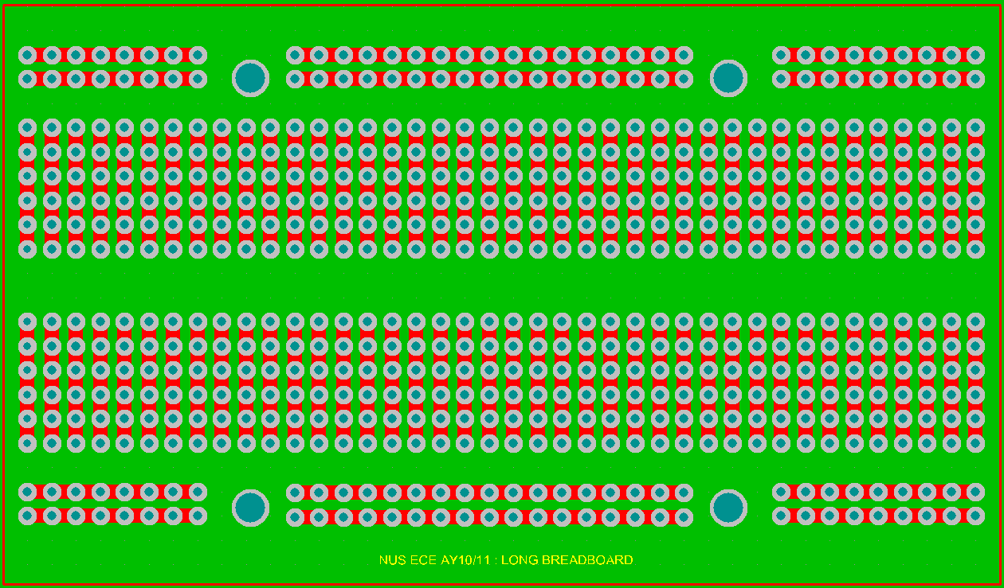
Long Breadboard PCB
If you wish to transfer your circuits on the breadboard to a PCB, you can consider using this PCB.
It is designed to have connections exactly like a breadboard.

